Slide 1
Acquiring a GSLifestyle Account & Card in 12 Steps

Slide 2
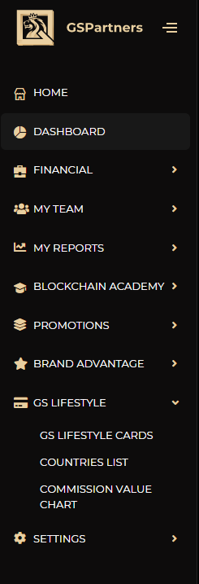
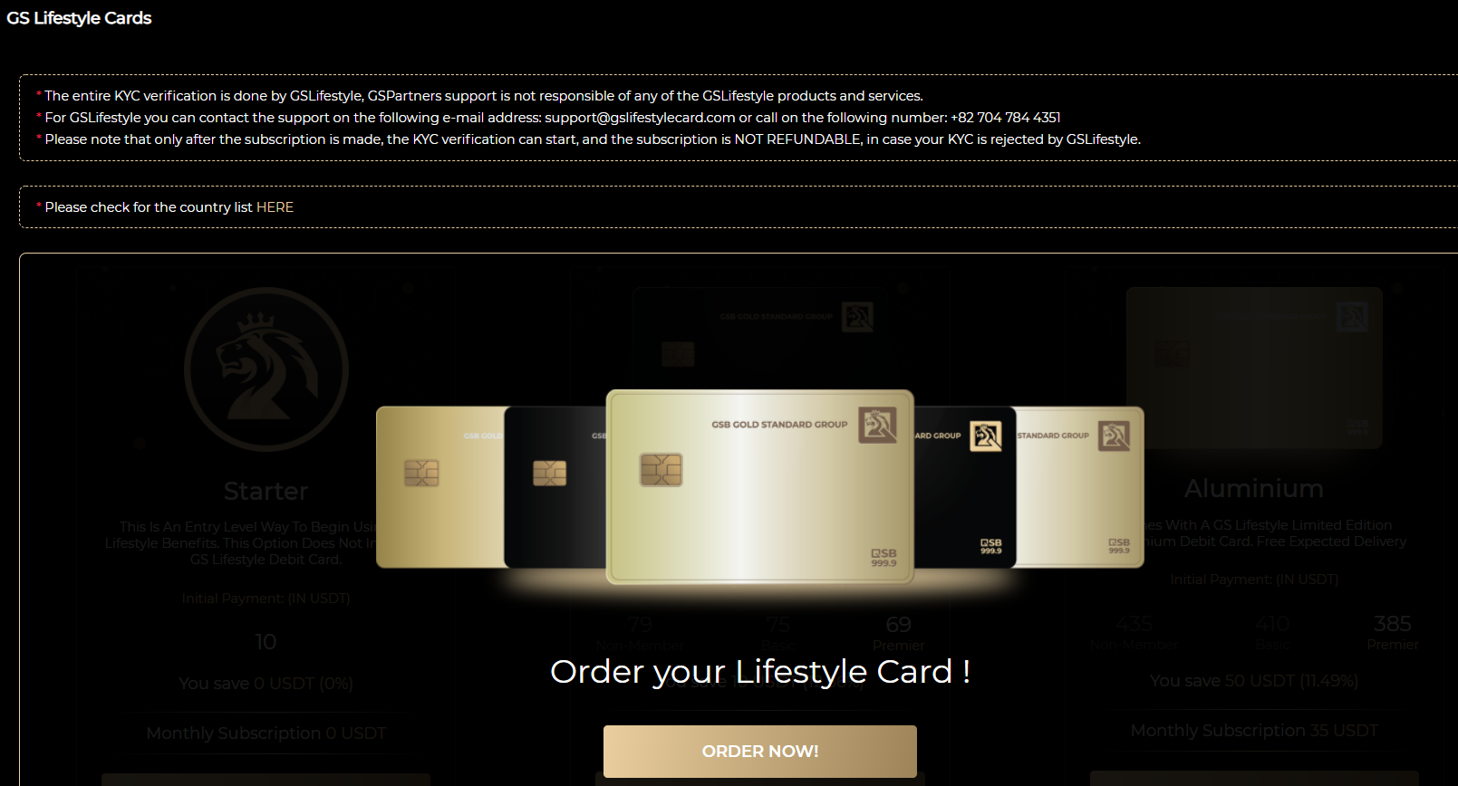
1. Click: GSLifestyle > GSLIfestyle Cards
2. Click: ORDER NOW!

Slide 3
3. Choose your tier of GSL Membership

Slide 4
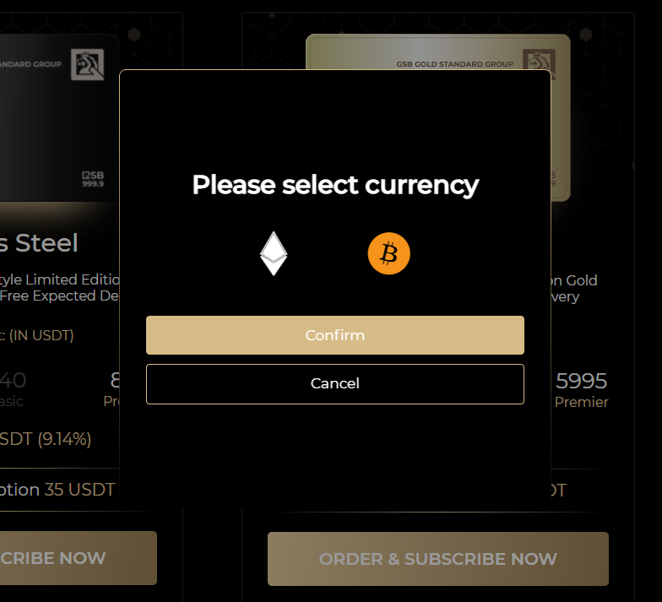
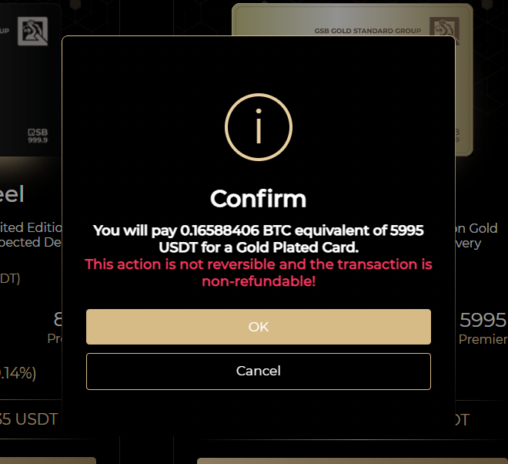
5. Select your checkout currency
6. Confirm your action

Slide 5
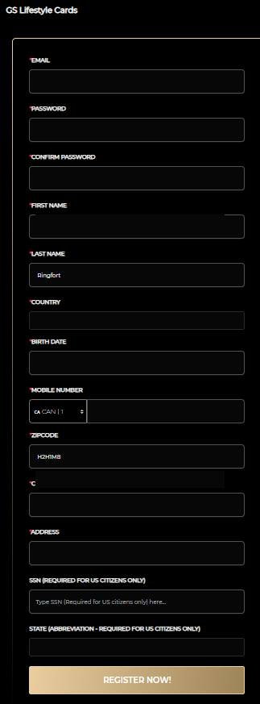
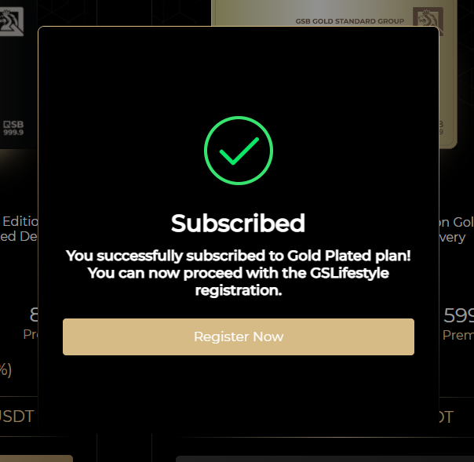
7. Click: Register Now
8. Fill out the form

Slide 6
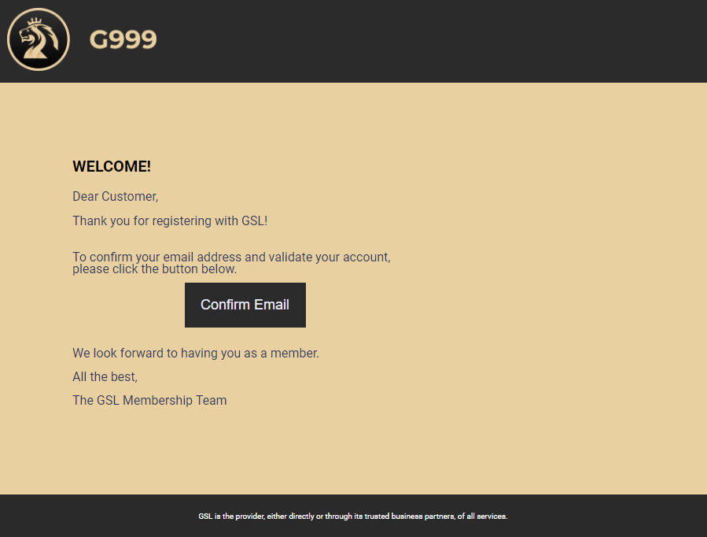
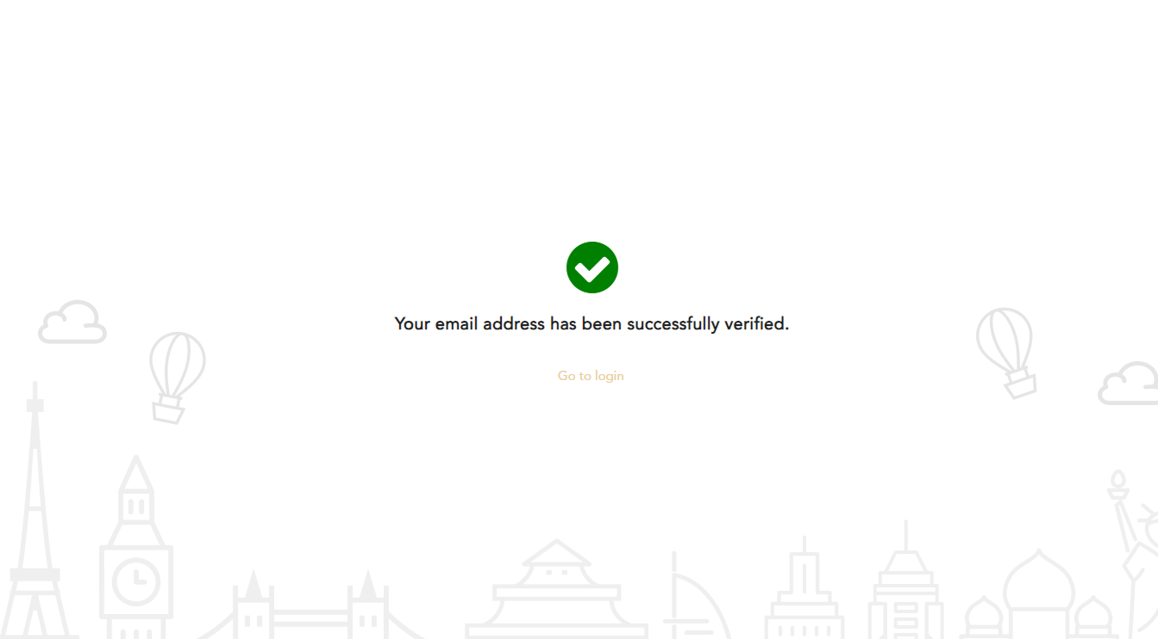
9. Wait for Registration email and click Confirm Email
10. Email is Verified

Slide 7
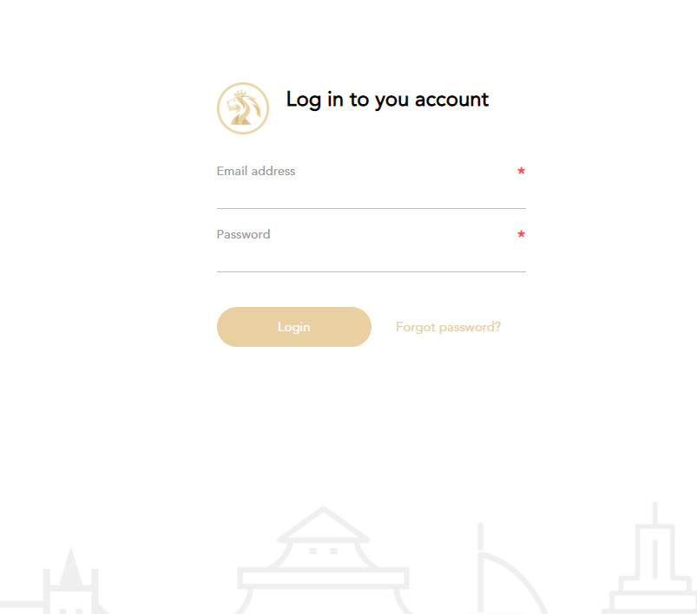
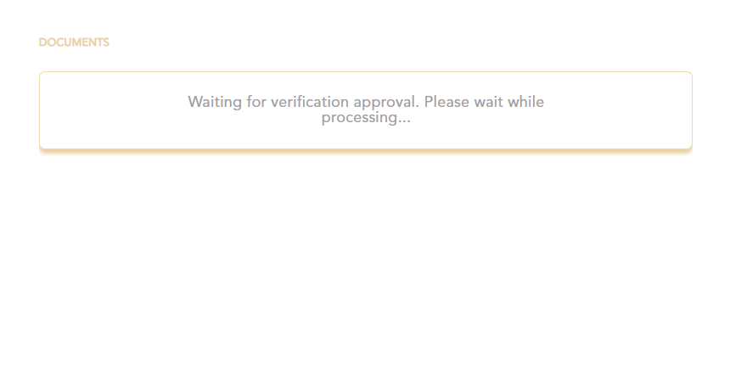
11. Login to GSLifestyle
12. Upload KYC and Wait for it to be approved

